Slide 1


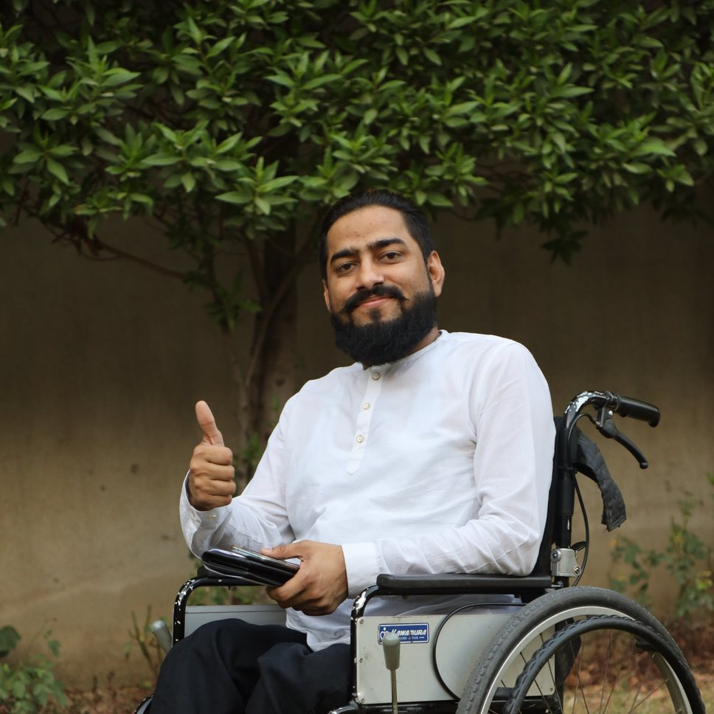
ALKHIDMAT VOLUNTEER CLUB GUJRANWALA PRESENTS
AI & Entrepreneurship
Turning Ideas into Successful Businesses
Raheel Nawaz
Digital Entrepreneur · Founder & CEO, TechNow Pakistan · ForexUstaad
20 October 2026 · 9:00 – 10:00 PM · Google Meet
"Mujhe meri salahiyat se pehchano, majboori se nahi."
RN
© 2026 Raheel Nawaz · raheelnawaz.com · Alkhidmat Volunteer Club Gujranwala
1
Notes:
Assalam o Alaikum. Alkhidmat Volunteer Club Gujranwala ka shukriya. Aaj ka sawal: AI aur entrepreneurship mil kar ek idea ko business kaise banate hain. Ek ghanta — kahani, haqeeqat, AI ka live demo, aur 30 din ka plan. Click 1: title, Click 2: apna taaruf, Click 3: waqt, Click 4: slogan.

Slide 2
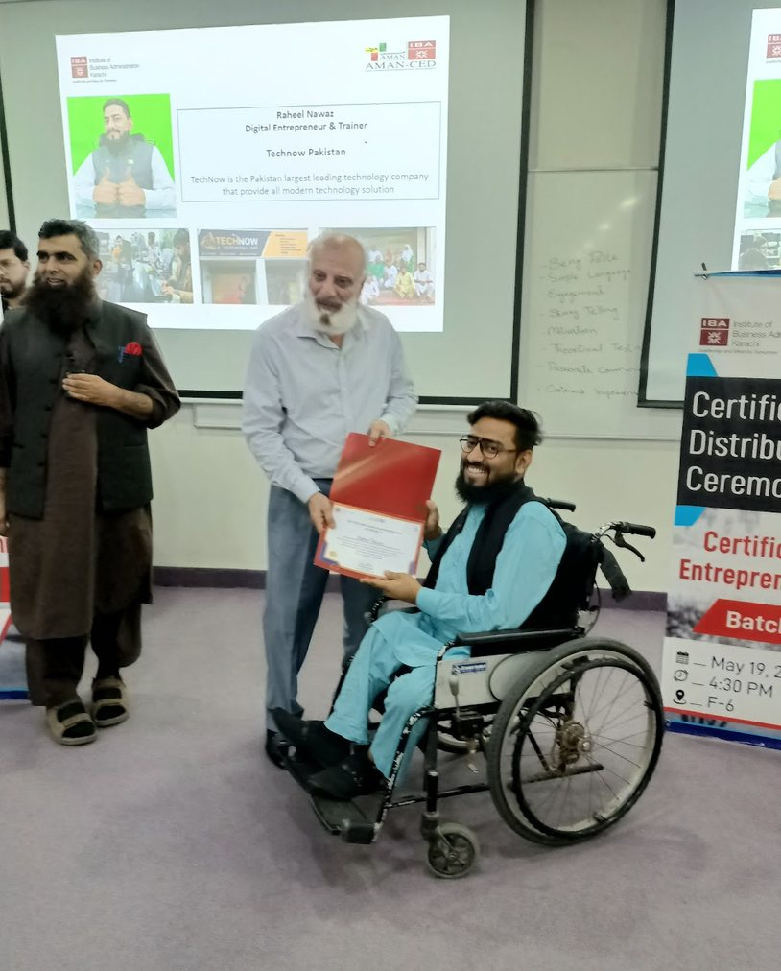
Main kaun hoon?
Wheelchair par baitha ek entrepreneur — jis ne apni salahiyat ko apni pehchan banaya
2010
Financial markets mein pehla qadam
Trading seekhi, ghaltiyon se seekha — 15 saal ka tajurba
2014
ForexUstaad ki bunyaad
Urdu/Hindi mein trading education — 50,000+ students
2015
Exness Partner of the Year
International pehchan, Pakistan se
2016
TechNow Pakistan
Ek office mein akela shuru kiya — aaj 10+ ventures
IBA
IBA Karachi Entrepreneurship
Graduate + Lions Club leadership (RLLI) — aur Roaring Lion Award
RN
© 2026 Raheel Nawaz · raheelnawaz.com · Alkhidmat Volunteer Club Gujranwala
2
Notes:
Apni kahani mukhtasar: 2010 mein markets, 2014 mein ForexUstaad, 2015 Exness award, 2016 TechNow akele office se. Wheelchair ki wajah ya saal nahi batana — sirf salahiyat. Har click par ek milestone. Paigham: agar main kar sakta hoon, to aap bhi kar sakte ho.

Slide 3
Pakistan ka moqa: abhi, isi waqt
Yeh numbers batate hain ke darwaza khula hai
$4.6B
$1B+
10 Lakh
IT exports — FY2026
Record level, pichle saal se 21% zyada
Freelancers ki kamai
23 lakh+ registered freelancers — duniya ki 4th bari freelance market
AI trained naujawan
National AI Policy 2025 ka target — 2030 tak
Moqa darwaze par hai. Sawal yeh hai: kya hum taiyar hain?
Source: Express Tribune (Jul 2026), MEA Tech Watch (Feb 2026), ProPakistani (Oct 2025)
RN
© 2026 Raheel Nawaz · raheelnawaz.com · Alkhidmat Volunteer Club Gujranwala
3
Notes:
Teen numbers: IT exports 4.6 billion dollar record, freelancers ne pehli dafa ek arab dollar se zyada kamaya, aur hukoomat 2030 tak das lakh logon ko AI sikhana chahti hai. Sawal audience se: aap mein se kitne log ChatGPT roz use karte hain? Chat mein haan likhein.

Slide 4
AI ne business ka game badal diya
Duniya ke chhote business kya kar rahe hain — aur Pakistan ki haqeeqat kya hai
77%
chhote business AI regularly use karte hain
Pakistan ki haqeeqat
Startup funding 2025: $36.6M
2022 mein yahi $331M thi — yaani investor ka paisa bohat kam ho gaya.
Sabaq: investor ka intezar mat karo. AI ke saath kam paise se shuru karo, pehle customer se paisa kamao.
78%
kehte hain productivity barh gayi
43%
kehte hain revenue barh gaya
Source: Intuit QuickBooks 2026 AI Impact Report (US small & mid businesses)
Source: Data Darbar via Profit (Jan 2026)
RN
© 2026 Raheel Nawaz · raheelnawaz.com · Alkhidmat Volunteer Club Gujranwala
4
Notes:
Bahar ke chhote business mein 77% AI use kar rahe hain. Pakistan mein startup funding 2022 ke muqable mein takreeban das percent reh gayi hai. Is ka matlab: bootstrap karo — AI aap ka sasta staff hai. Pehle chhota shuru, phir barhao.

Slide 5
Idea se business tak: 4 qadam
Bara plan baad mein — pehle chhota, sacha aur test kiya hua qadam
1
2
3
4
Masla dhoondo
Apne mohalle, apni community ka asli masla. Volunteer hone ke naate aap yeh pehle se jaante ho.
Chhota test karo
Ek WhatsApp post, 10 logon se baat. Paisa lagane se pehle pucho: kya aap is ke paise doge?
Pehla customer
Pehla paisa sab se bara proof hai. Feedback lo, behtar karo.
System banao
Jo kaam bar bar ho — posts, jawab, hisaab — woh AI aur tools ko do.
RN
© 2026 Raheel Nawaz · raheelnawaz.com · Alkhidmat Volunteer Club Gujranwala
5
Notes:
Chaar qadam. Social entrepreneurship ka zikr: business jo community ka masla hal kare aur paisa bhi kamaye. Misaal: tuition, ghar ka khana, mobile repair, Canva design service. Audience se pucho: aap ke ilaqe ka sab se bara masla kya hai? Chat mein likhein.

Slide 6
AI = aap ka sasta aur tez co-founder
6 kaam jo pehle team karti thi, ab AI tools ki madad se aap khud kar sakte ho
R
Research
ChatGPT / Claude / Gemini se market, customer aur competitors samjho
B
Branding
Naam, tagline aur logo ke ideas minutes mein
C
Content
Posts, captions, video scripts — Urdu aur English dono mein
D
Design
Canva AI se poster, flyer aur social media graphics
W
Website / App
Lovable jaise tools — bina coding ke website
S
Customer Support
WhatsApp auto-reply bot — 24 ghante jawab
RN
© 2026 Raheel Nawaz · raheelnawaz.com · Alkhidmat Volunteer Club Gujranwala
6
Notes:
AI kaam asaan karta hai, soch aap ki honi chahiye. Har card ke saath apni misaal: TechNow aur ForexUstaad mein hum content, design aur WhatsApp bot AI se chalate hain. Yaad dilana: AI ka jawab hamesha check karo, copy-paste nahi.

Slide 7
Live Demo: 1 idea, 5 prompts
Misaal: "Gujranwala mein ghar ka bana khana — office walon tak"
1
Gujranwala mein ghar ke khane ki delivery ke liye 5 asli masail aur 3 customer types batao.
2
Is business ke 10 naam aur ek Urdu tagline do.
3
Pehle mahine ka 5,000 rupay ka budget aur kaam ka plan banao.
4
Facebook aur WhatsApp ke liye 7 din ki posts likho.
5
Customers ke 10 aam sawalon ke jawab likho, WhatsApp bot ke liye.
Tip: AI ko apni zubaan, apna sheher aur apna budget batao — jawab utna hi behtar aayega.
RN
© 2026 Raheel Nawaz · raheelnawaz.com · Alkhidmat Volunteer Club Gujranwala
7
Notes:
Screen share karo, ChatGPT ya Claude kholo aur yeh prompts live chalao. Behtar: audience se unka idea chat mein mangwao aur usi par demo karo. 10-12 minute is par lagao — yeh session ka sab se yaadgaar hissa hoga.

Slide 8
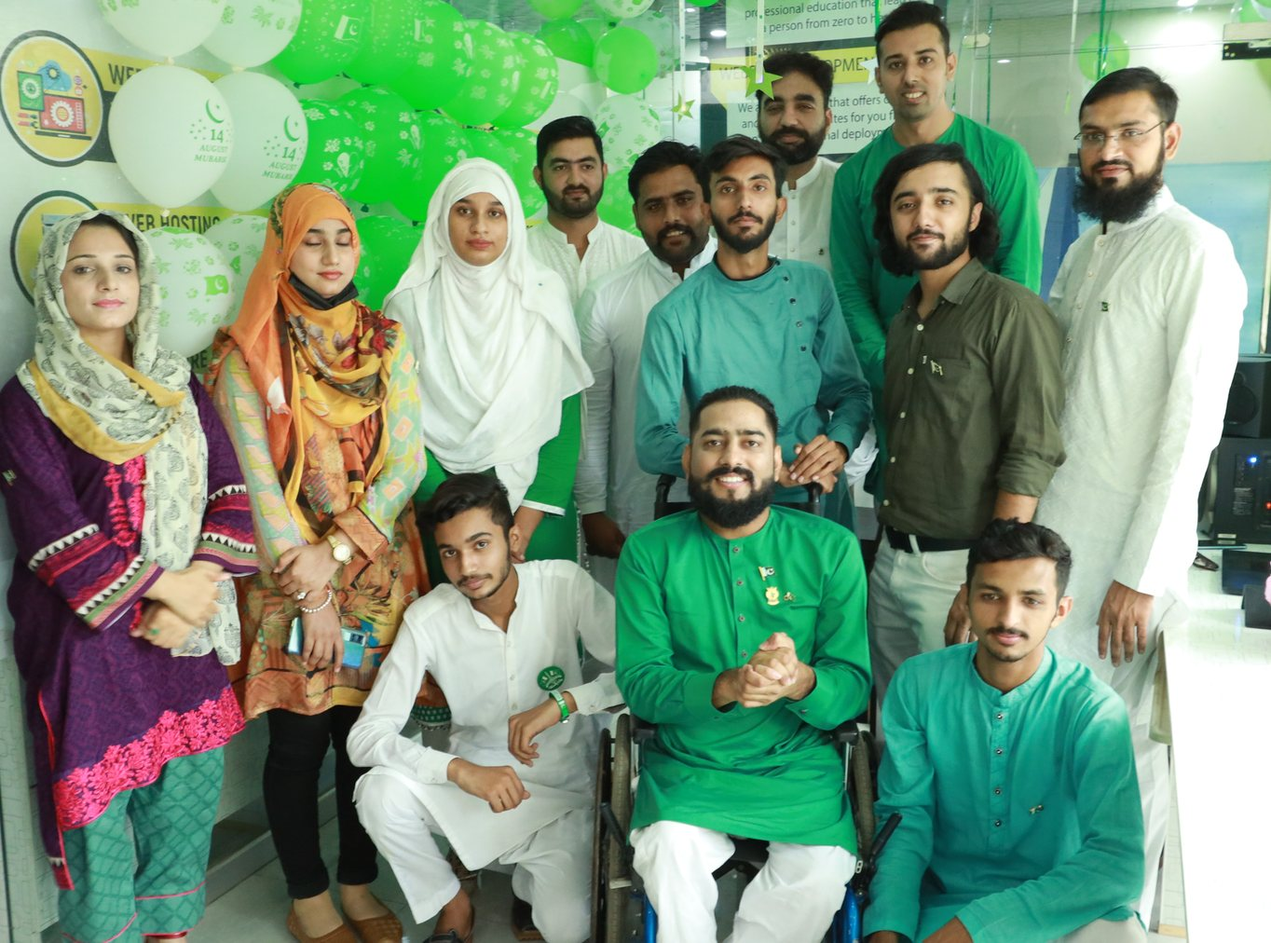
Meri sab se bari business lesson
Kamyabi tez bhagna nahi — lamba chalna hai
"Utna phailo, jitna sambhal sako."
1
2016 mein ek office mein akela shuru kiya — phir team banai
2
Kharcha control, expansion soch samajh kar
3
Kabhi itna nahi phaila ke dukaan band karni pare
4
Isi liye 10 saal baad bhi TechNow chal raha hai
TechNow Pakistan team
RN
© 2026 Raheel Nawaz · raheelnawaz.com · Alkhidmat Volunteer Club Gujranwala
8
Notes:
Yeh apna asli sabaq hai: business ko lamba chalana. Koi specific crore figure nahi batana. Naujawan aksar pehle hi bara office, bari team, bara kharcha kar lete hain — phir band. Pehle kamao, phir phailo.

Slide 9
5 ghaltiyan jo naye entrepreneur karte hain
In se bach gaye to aadha safar asaan
✕
Perfect waqt ka intezar
Waqt kabhi perfect nahi hota — aaj chhota shuru karo
Volunteer ka chhupa faida
Aap roz community ke masail dekhte ho — logon ki zarurat, unki pareshani. Yahi sab se bara business idea hai.
Jo kaam aap khidmat ke liye karte ho, wahi skill kal aap ka business ban sakti hai: social entrepreneurship.
✕
Bina test ke bara kharcha
Pehle 10 log, phir paisa
✕
AI ka copy-paste
AI draft deta hai, soch aur check aap ka kaam hai
✕
Sirf naukri ka intezar
Parhai ke saath skill aur side income banao
✕
Akele sab kuch karna
Mentor, community aur team se seekho
RN
© 2026 Raheel Nawaz · raheelnawaz.com · Alkhidmat Volunteer Club Gujranwala
9
Notes:
Paanch ghaltiyan, har click par ek. Phir volunteer card: Alkhidmat ke volunteers ko yaad dilao ke unke paas community ka asli data aur bharosa hai — yeh kisi bhi business ki bunyaad hai.

Slide 10
Aap ka 30 din ka action plan
Worksheet mein yahi plan likha hai — aaj raat se shuru
Hafta 1
Masla chuno
Ek masla, 10 logon se baat. Notes banao.
Hafta 2
AI se plan
Naam, offer, budget aur 7 din ki posts AI ki madad se.
Hafta 3
Chhota test
Pehli post, pehli offer. Kitne log pooch rahe hain?
Hafta 4
Pehla customer
Pehla paisa, feedback, behtari. Phir agla qadam.
Shart sirf ek: roz 1 ghanta. Parhai aur khidmat ke saath.
RN
© 2026 Raheel Nawaz · raheelnawaz.com · Alkhidmat Volunteer Club Gujranwala
10
Notes:
Worksheet ka zikr karo: raheelnawaz.com par free registration ke baad milegi. Koi zabardasti nahi, koi paisa nahi. Jo 30 din poore kare, WhatsApp par apna result bheje.

Slide 11
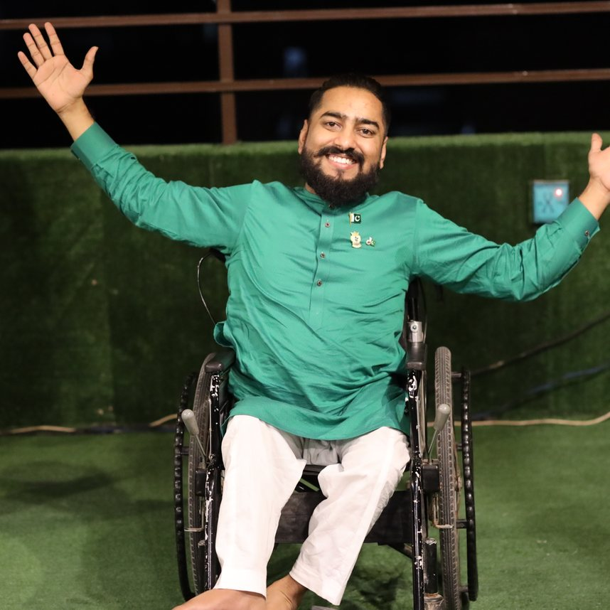
Shukriya! Ab aap ke sawal.
Free slides, worksheet aur resources
raheelnawaz.com (free registration)
WhatsApp par seedha rabta
+44 7456 436080 · wa.me/447456436080
Facebook: WheelchairWala – Raheel Nawaz · Instagram: @rnjutt · TikTok: @raheelnawaz007 · X: @raheel_jutt
"Mujhe meri salahiyat se pehchano, majboori se nahi."
RN
© 2026 Raheel Nawaz · raheelnawaz.com · Alkhidmat Volunteer Club Gujranwala
11
Notes:
Alkhidmat Volunteer Club Gujranwala aur sab volunteers ka shukriya. raheelnawaz.com par free registration se slides aur worksheet. WhatsApp number screen par. Phir Q&A — 10 minute. Aakhir mein slogan khud bol kar khatam karo.

